Slide 1
Workflows
Module - 13

Slide 2
Contents
Overview
Data Model
Working with workflows
Automated steps

Slide 3
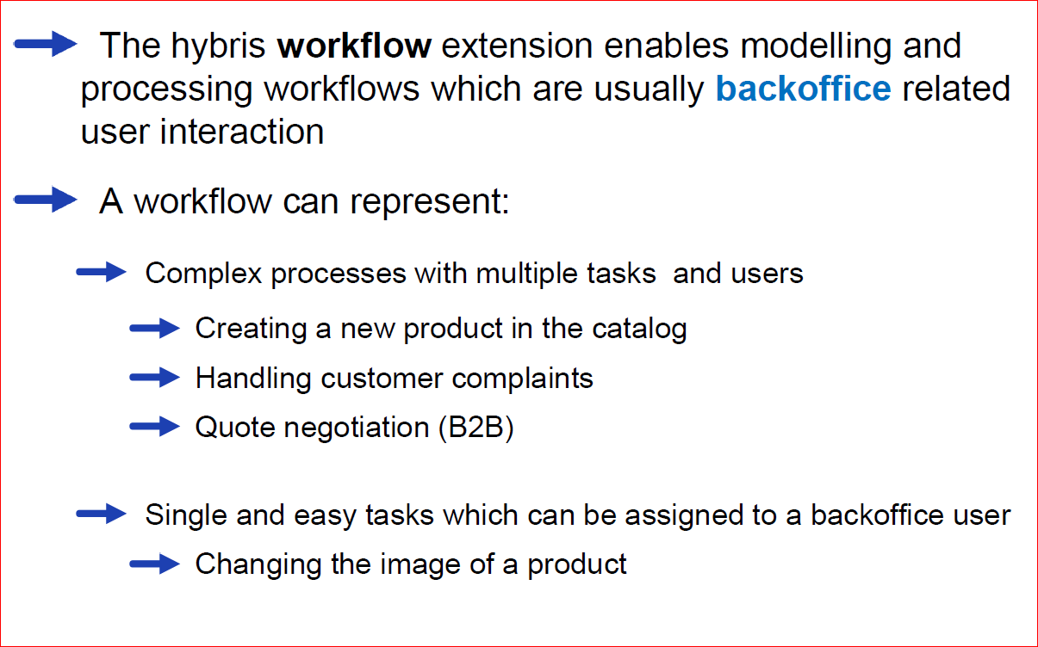
Overview

Slide 4
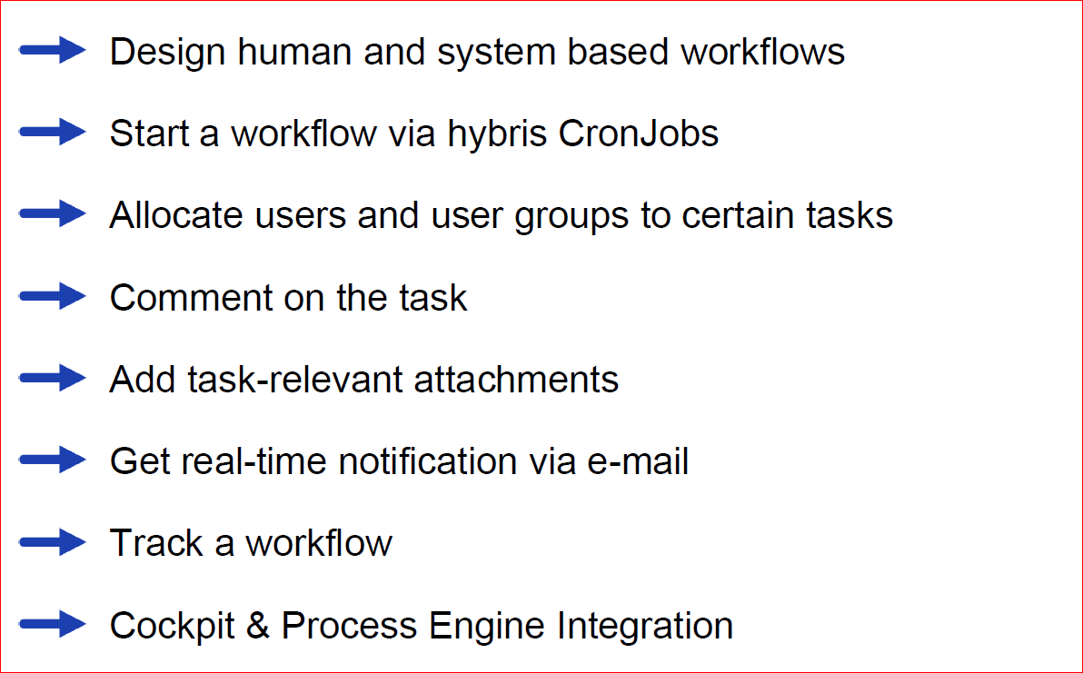
Workflow Module – Key features

Slide 5
Contents
Overview
Data Model
Working with workflows
Automated steps

Slide 6
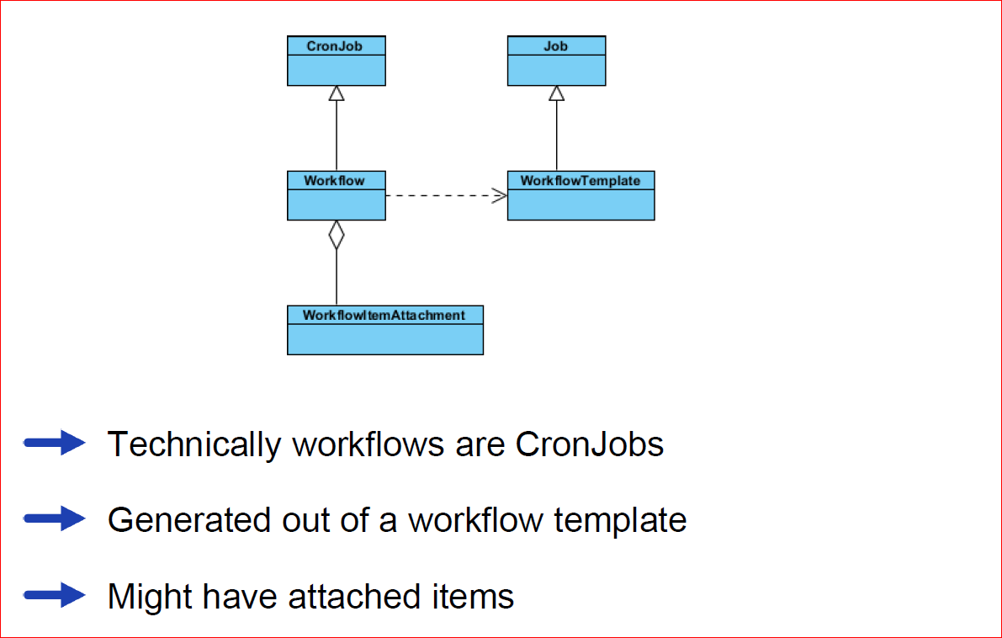
Workflow

Slide 7
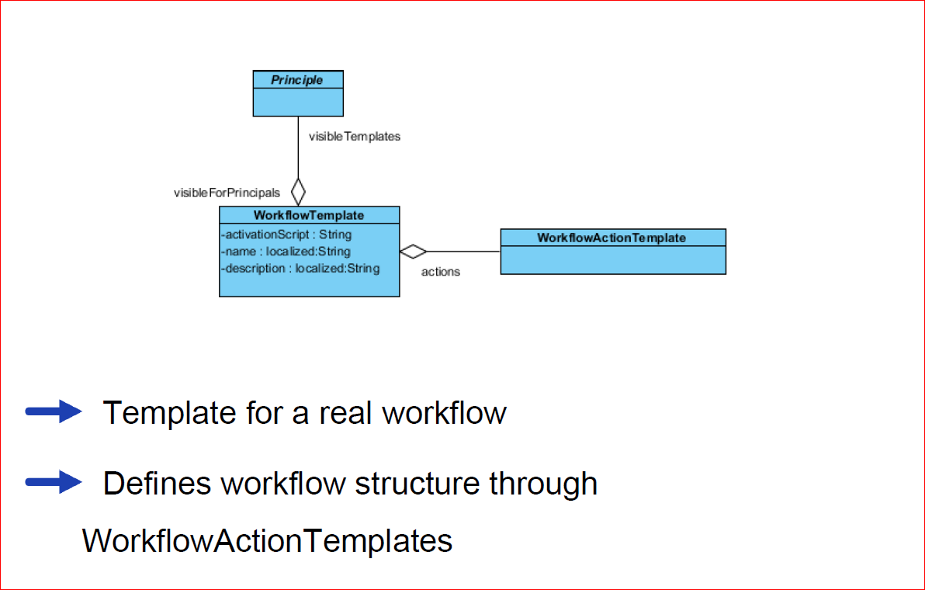
Workflow Template

Slide 8
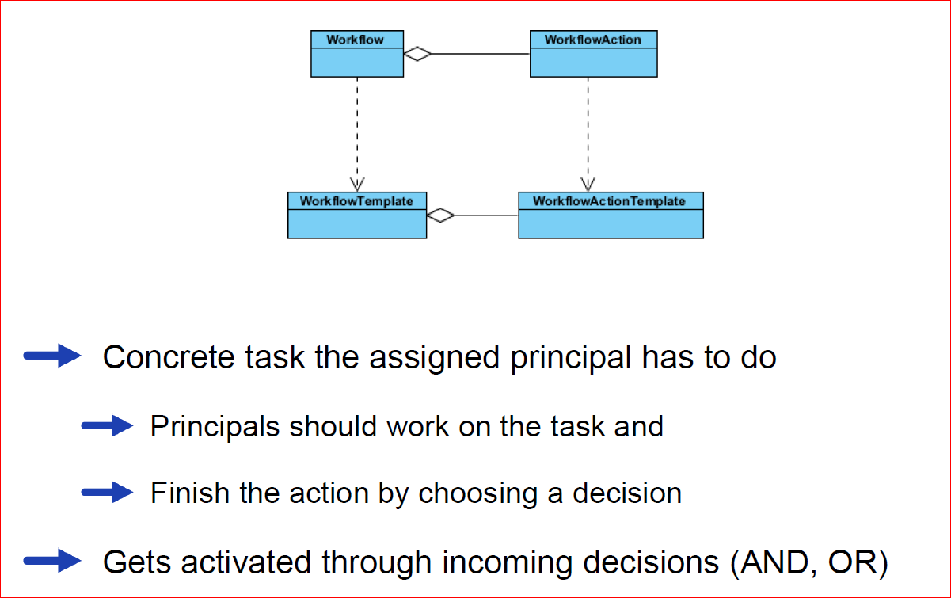
WorkflowAction

Slide 9
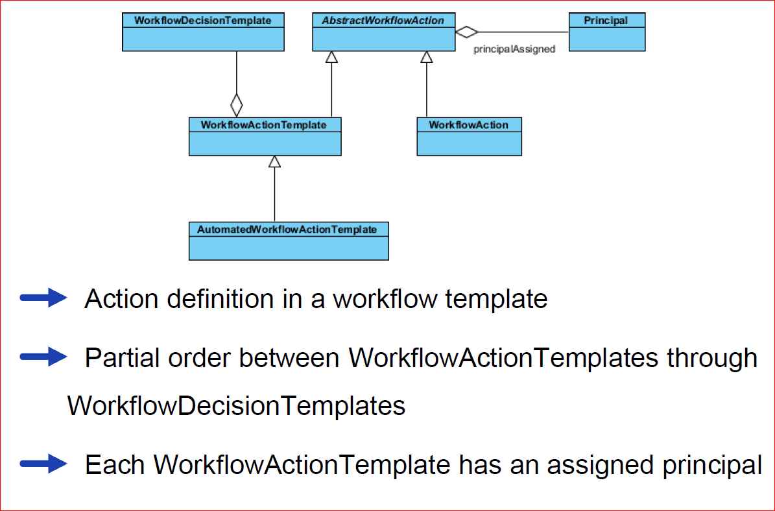
WorkflowActionTemplate

Slide 10
Contents
Overview
Data Model
Working with workflows
Automated steps

Slide 11
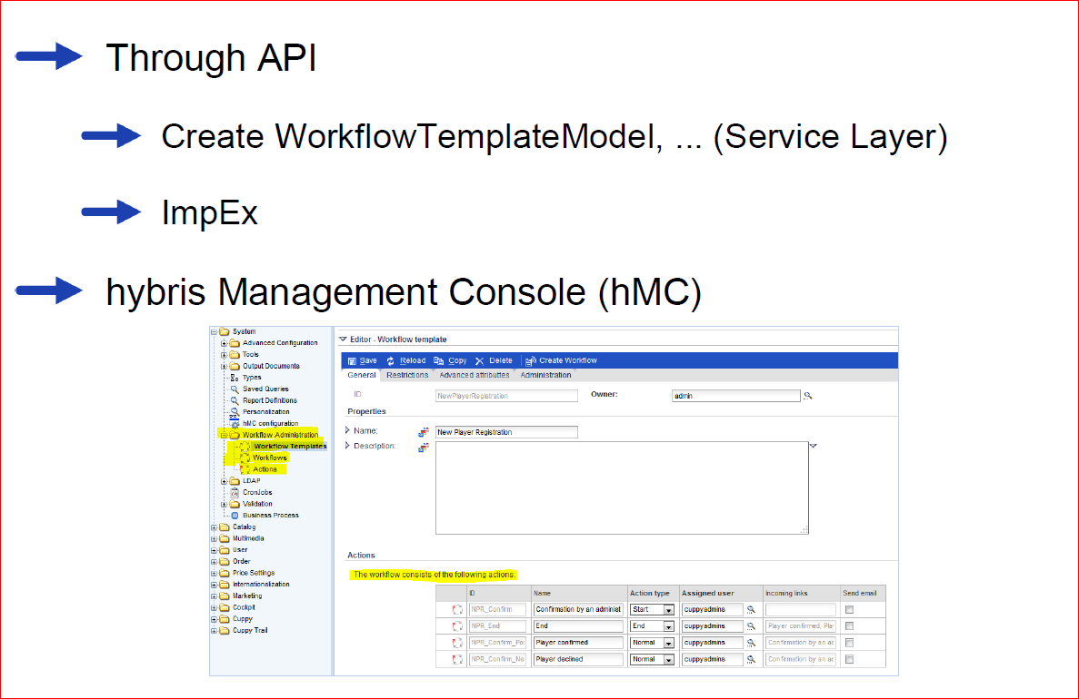
Modeling a Workflow

Slide 12
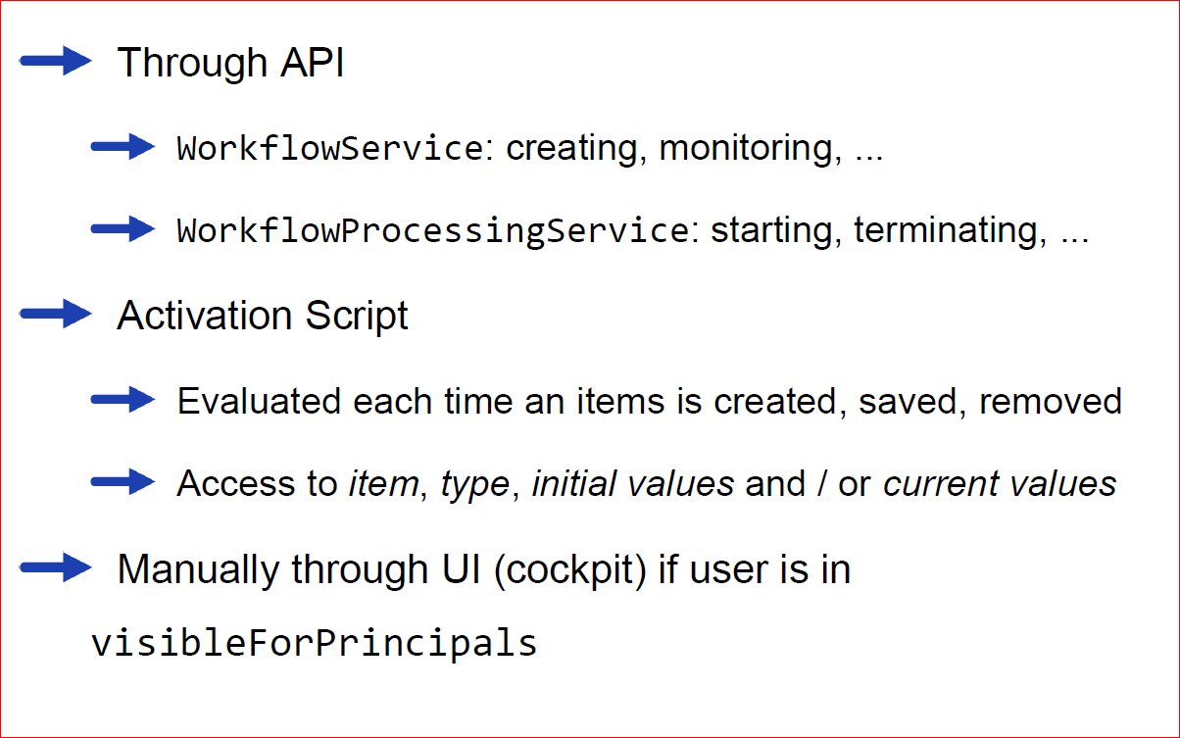
Starting a Workflow

Slide 13
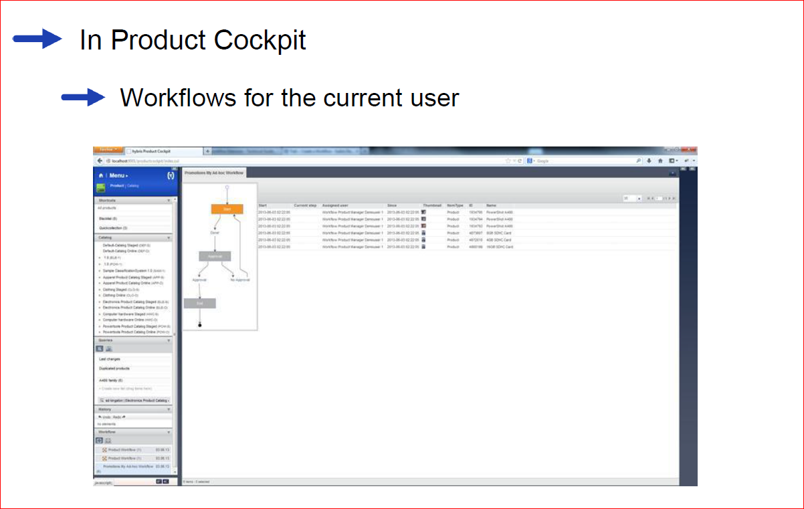
Displaying Workflows

Slide 14
Contents
Overview
Data Model
Working with workflows
Automated steps

Slide 15
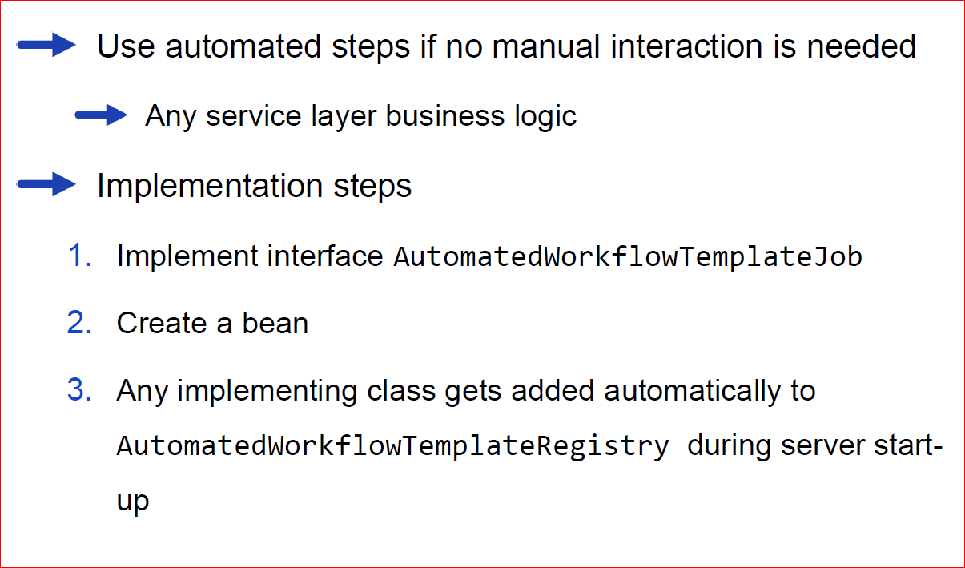
Automated steps in a workflow

Slide 16
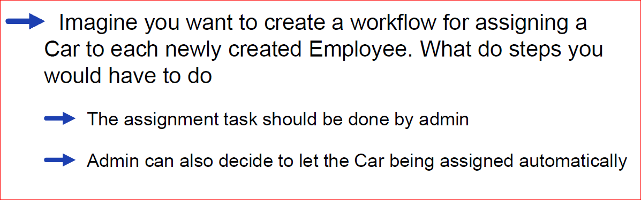
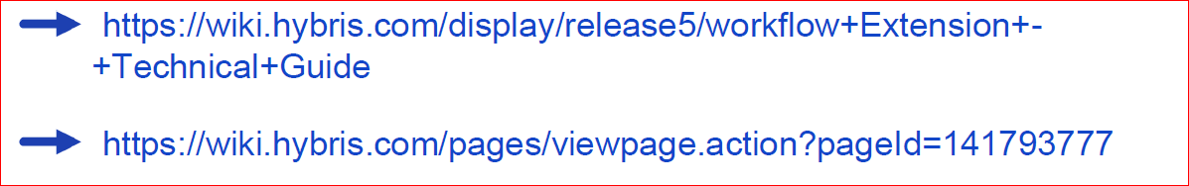
Quizzies & References

